Slide 1
Recognizing Facial Features with TensorFlow
Eric Allen
Thinkful Data Science Bootcamp

Slide 2
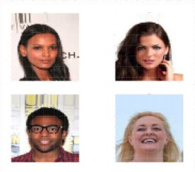
The Data
Kaggle Link: https://www.kaggle.com/jessicali9530/celeba-dataset/home
If you would to checkout the dataset
Originally Collected by MMLAB, The Chinese University of Hong Kong
Dataset contains 202,599 images of various celebrities faces
Images have a variety of different backgrounds
Csv file that contains 40 binary attributes
Image Id matches images file number

Slide 3
Concerns About the Data
There is a lot of bias in this training data
The different backgrounds could be seen as a feature
Celebrities clothing could be seen as a feature
No attribute for specific features
Ex… all 0 for eye color/hair color attributes

Slide 4
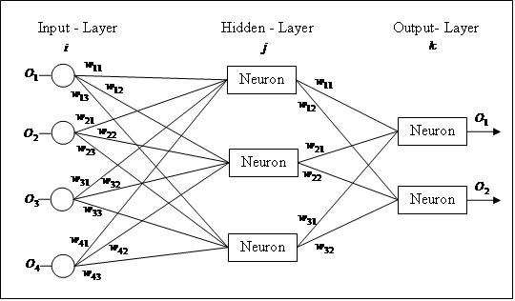
Supervised Model and Feature Prediction
The first model will aim to predict hair color
Target attributes
Black hair
Bald
Blond hair
Brown hair
Gray hair
Model Type
Sequential Model and KNN

Slide 5
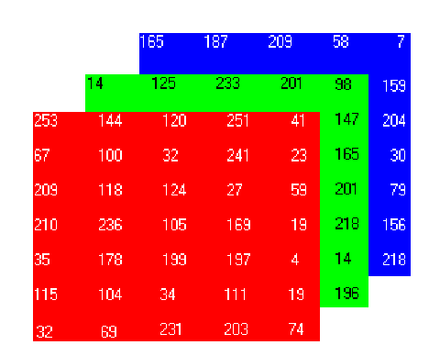
Preparing the Data/Images
Collect ID that have a hair color present
About 100,000 with attribute
Reshaping the images into a 64x64x3 array
For 64x64 of each color rgb
Use new arrays as X input
Attributes as y input
Split into train and test groups
test size 33%

Slide 6
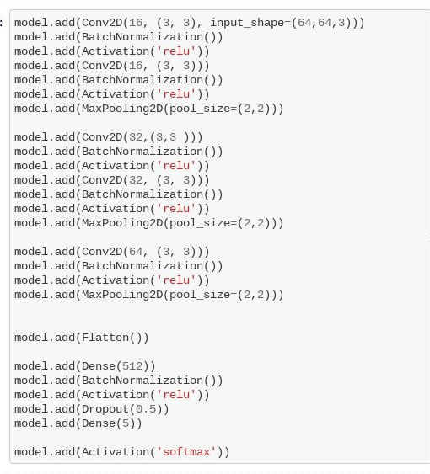
Setting Up Model
Network Layer Setup
Input shape matches array shape
Last dense matches # of attributes
Compiler
Categorical cross entropy for multiple targets
Rmsprop uses magnitude of recent gradients to normalize the gradients

Slide 7
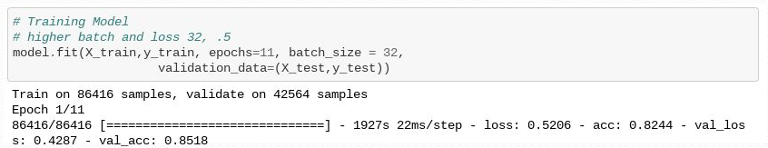
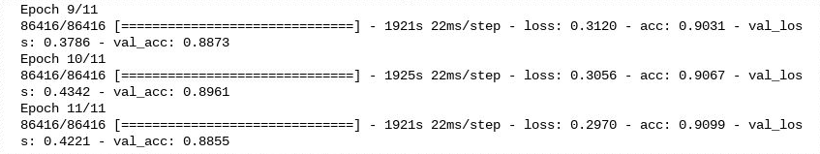
Training Model
Batch size
A higher batch lost ability to generalize effectively
Dropout Rate
0.5 is pretty high but prevents overfitting
Ignores input from 50% of neurons

Slide 8
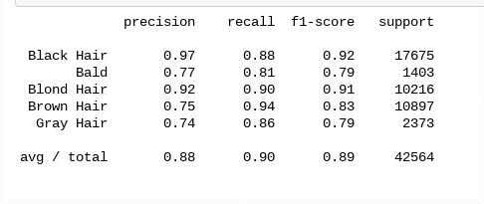
Analysis of Model
Break down by color
Some concerns / uneven group sizes
Simple solution - more data
Complex - kernel to filter images prior to processing

Slide 9
Application of Model
Why does this model matter?
Identify specific facial features could be used to develop many applications.
For example, identifying the user’s eye or face could be a valuable security tool
Used to developed filters like snapchat and Instagram.
Attribute like makeup, lipstick, and jewelry could be used on beauty filters.

Slide 10
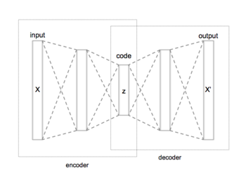
Feature Clustering
Goal to cluster celebrities with similar features
Measure with attributes from csv
Image prep
similar to first model without train test split
Autoencoder
Encoder to Decoder

Slide 11
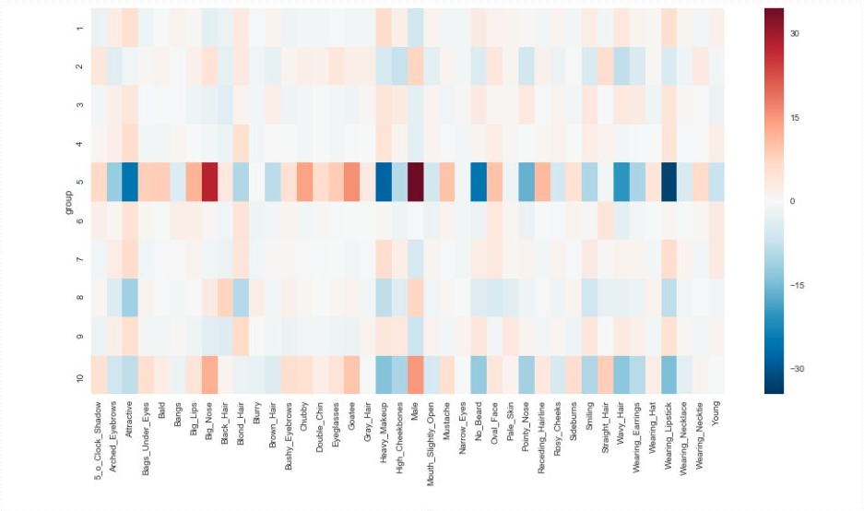
Show percent difference from all images

Slide 12
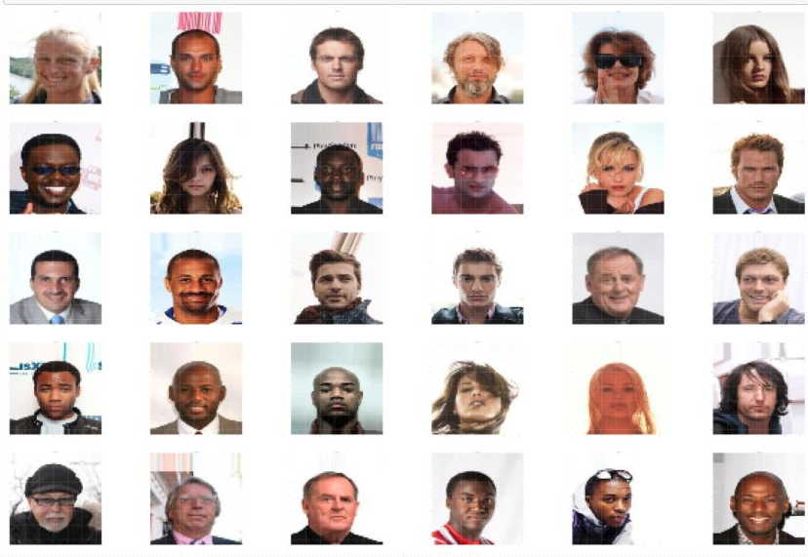
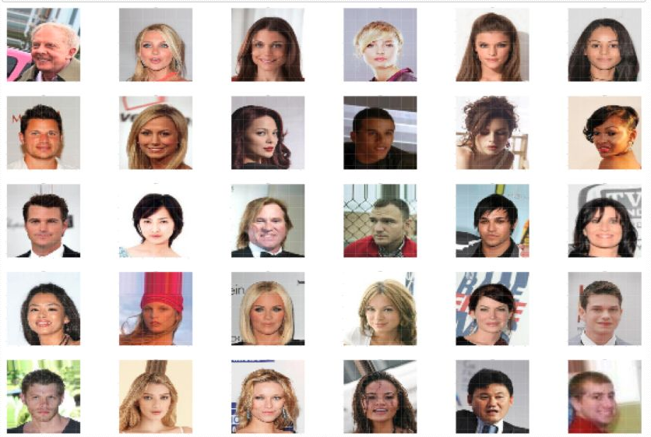
5
4

Slide 13
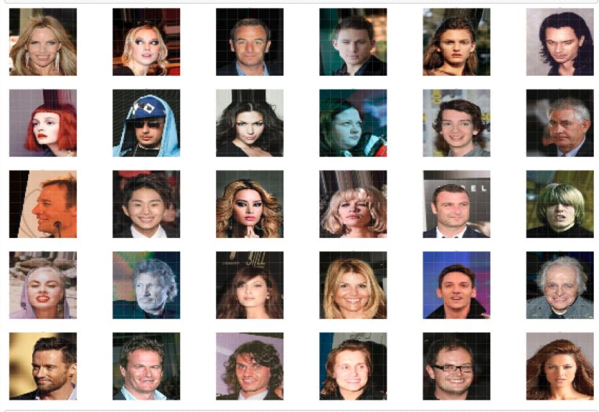
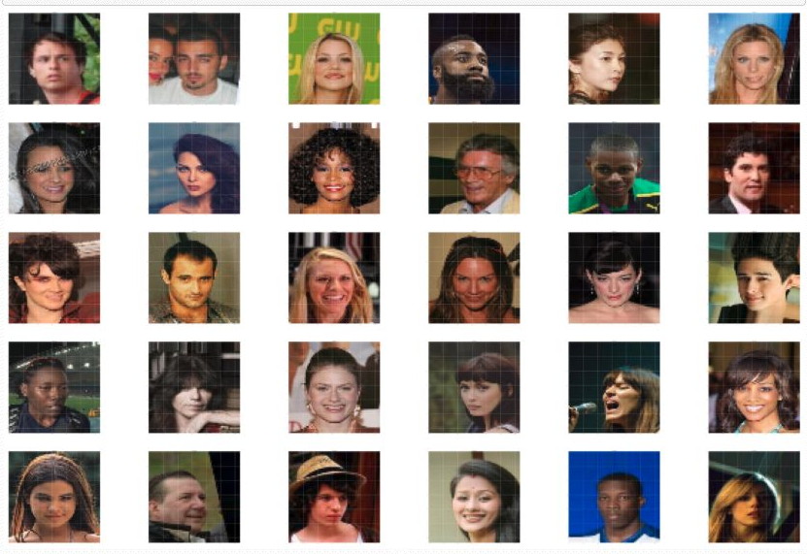
3
8

Slide 14
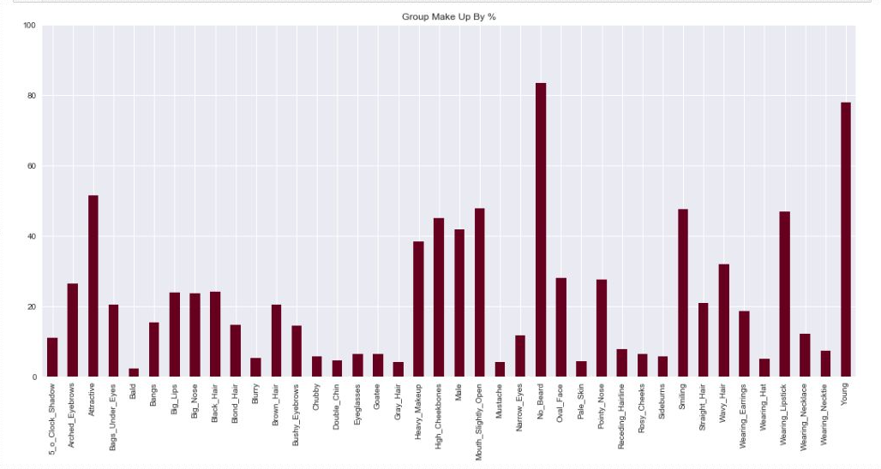
The Big Problem
This dataset is very biased with all the images being celebrities
Most of the attributes are overly abundant or very scarce

Slide 15
Solutions
More diverse data source
Fix the background with a detection kernel or segmentation
Improve clustering by Target a specific trait
Number of cluster equal to trait
Adding noise during autoencoding

Slide 16
Possible Applications
Sketch artist
App to slightly change feature through camera like Snapchat
Use a list of similar features to swipe through
Could be used alongside a search engine
Ex. google similar images

Slide 17
Questions?
Links
Dataset
https://www.kaggle.com/jessicali9530/celeba-dataset/home
Supervised notebook
https://github.com/etallen127/Final-Capstone/blob/master/Facial%20Recognition%20with%20TensorFlow%20-%20Supervised.ipynb
Unsupervised notebook
https://github.com/etallen127/Final-Capstone/blob/master/Facial%20Recognition%20with%20TensorFlow%20-%20Unsupervised.ipynb
Github
https://github.com/etallen127
Image display function
https://gist.github.com/soply/f3eec2e79c165e39c9d540e916142ae1

